Slide 1

Real time performance and safety monitoring in factory environment

Slide 2
E
B
C
A
E
D
Future work
Embedded system
Computer vision
Desktop Application
Introduction

Slide 3
A
B
C
D
E
E
Introduction
Computer vision
Embedded system
Desktop Application
Future work

Slide 4
E
B
C
A
E
D
Future work
Embedded system
Computer vision
Desktop Application
Introduction

Slide 5
E
A
Introduction

Slide 6





Motivation
Germany
Grand View Research
Euro stat Research
Markets And Markets Research

Slide 7
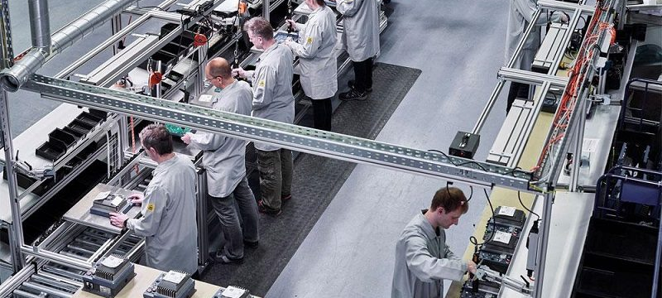
Germany

Slide 8
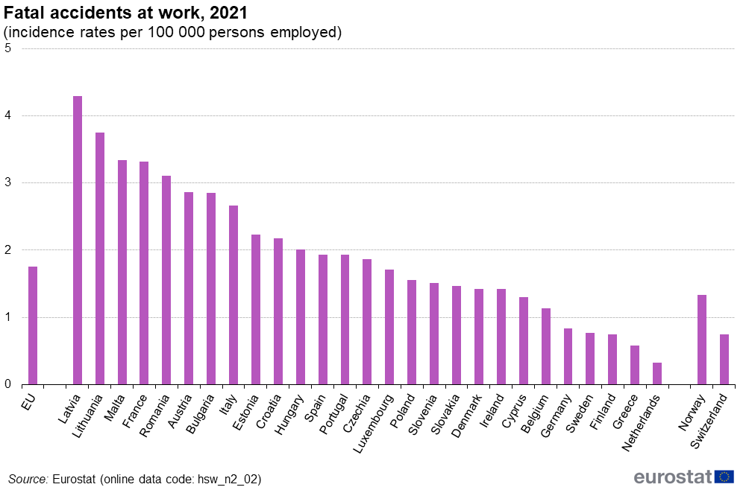
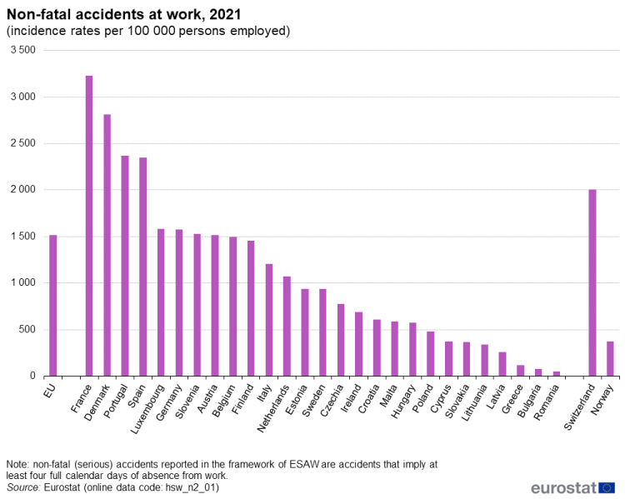

Slide 11
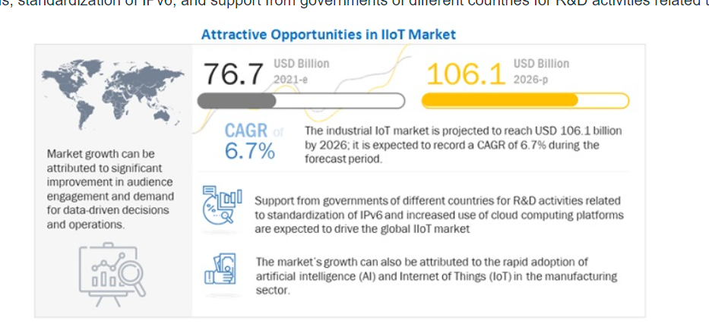
Markets And Markets Research

Slide 12
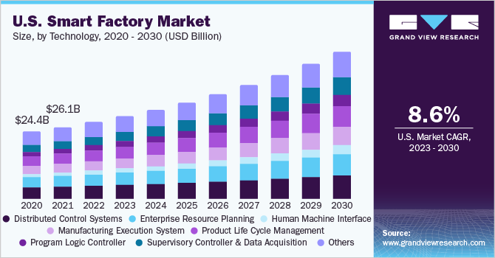
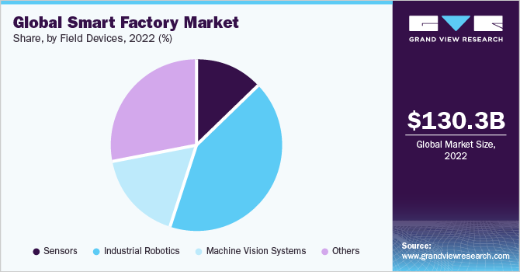
Grand View Research

Slide 13
E
B
C
A
E
D
Future work
Embedded system
Computer vision
Desktop Application
Introduction

Slide 14
E
C
A
D
B
Future work
Embedded system
Computer vision
Desktop Application
Introduction

Slide 15
Y.O.L.O
You Only Look Once.

Slide 16
YOLO
Why YOLO?

Slide 17



YOLO
Key Features
Speed
Accuracy
Simplicity
Notes:
Speed
Accuracy
Simplicity

Slide 18
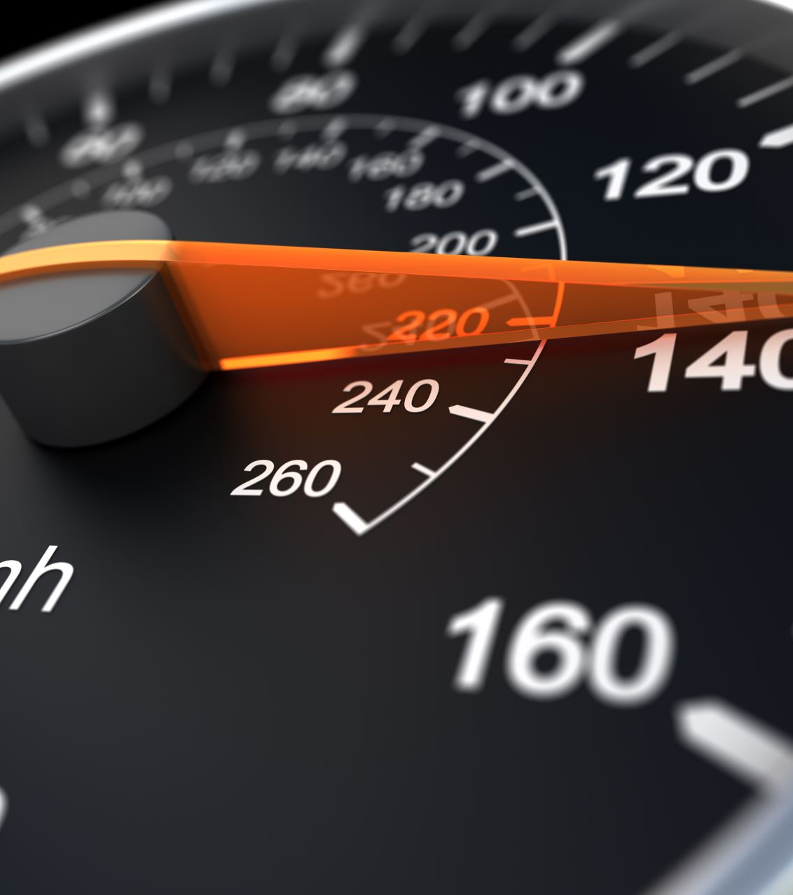
YOLO | Key Features
Speed
Real-time processing suitable for applications requiring instant results.

Slide 19
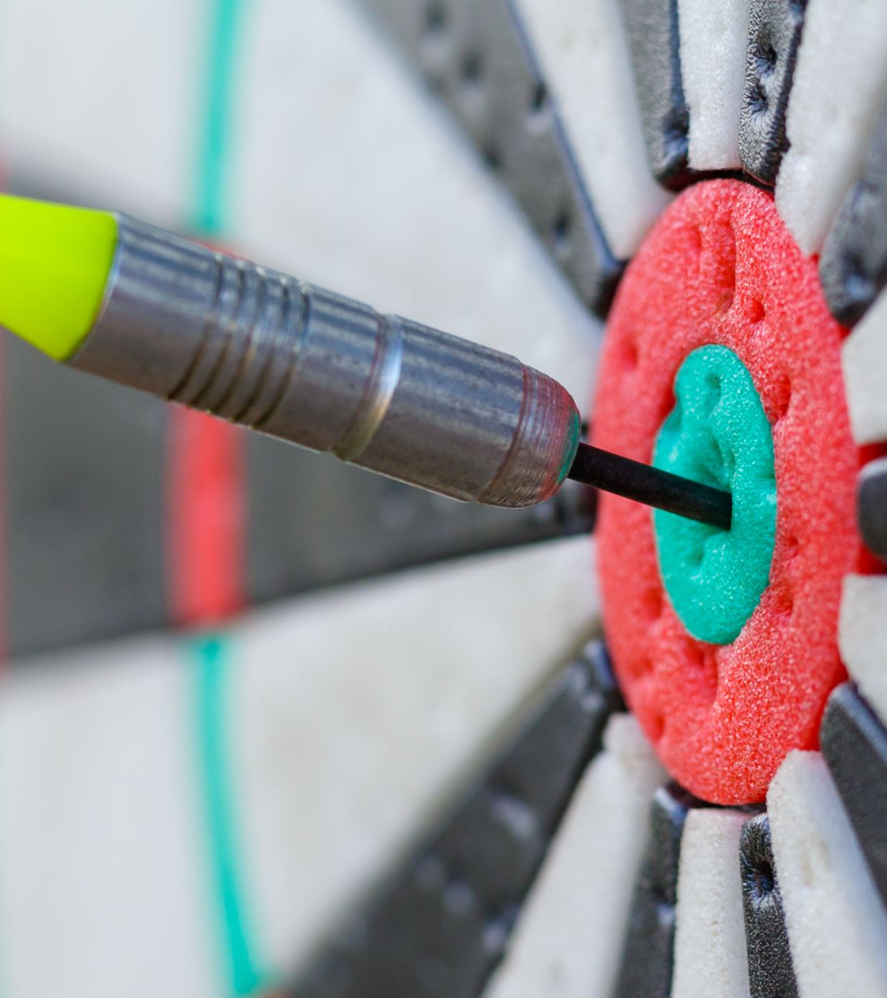
YOLO | Key Features
Accuracy
High accuracy for larger objects.
Robust to background noise.

Slide 20
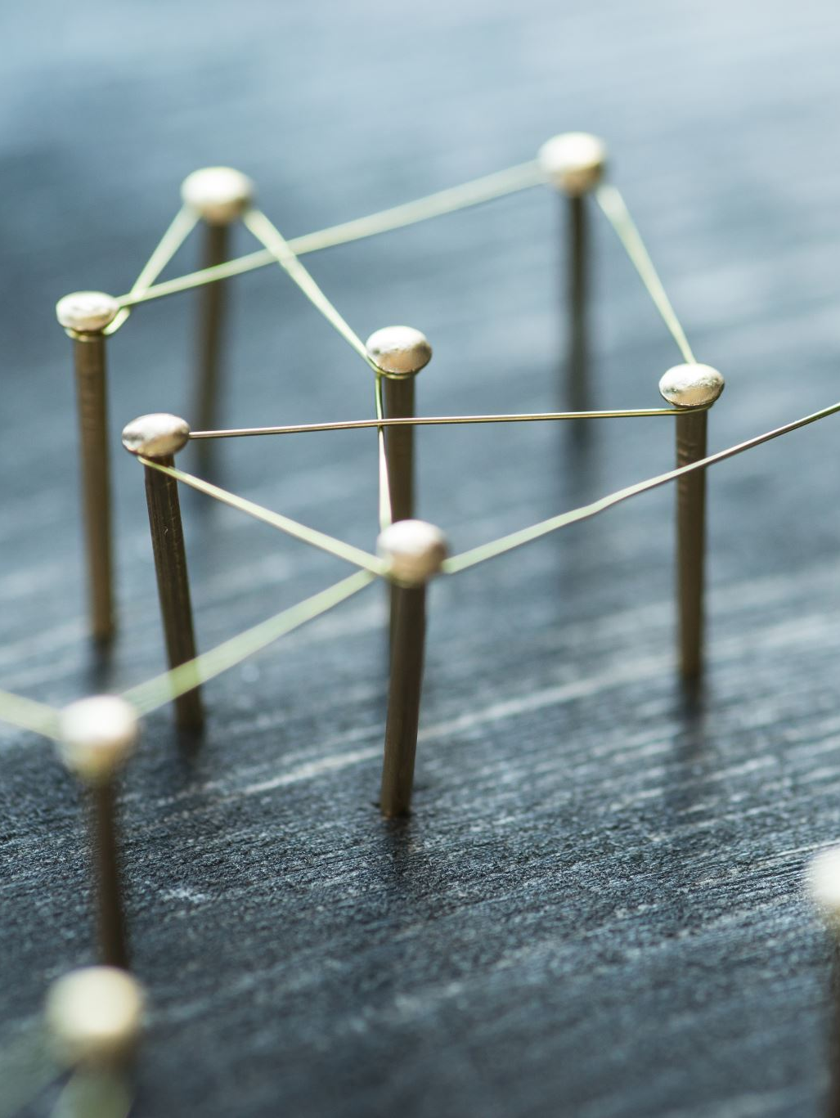
YOLO | Key Features
Simplicity:
Single neural network predicts bounding boxes and class probabilities directly from full images in one evaluation.

Slide 21
How YOLO Works
Stages of processing an image

Slide 22
YOLO
Steps
Dividing the Image
Bounding Box Prediction
Class Prediction

Slide 23
YOLO| Steps – Dividing the Image
Into S X S gird
Cells
Cell detects object

Slide 24
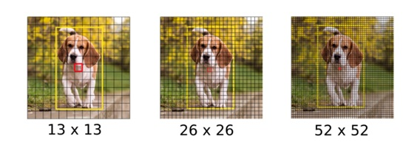
YOLO| Steps – Dividing the Image

Slide 25
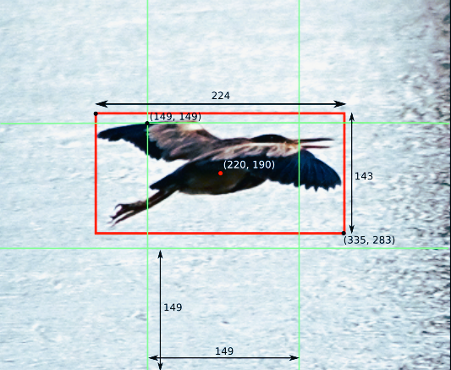
YOLO| Steps – Bounding Box Prediction
Bounding Box Details
Coordinate (x, y)
Width (w) and Height (H)
Confidence Score

Slide 26
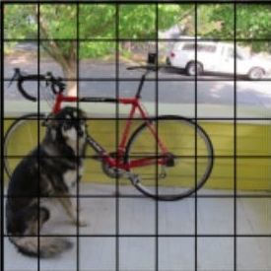
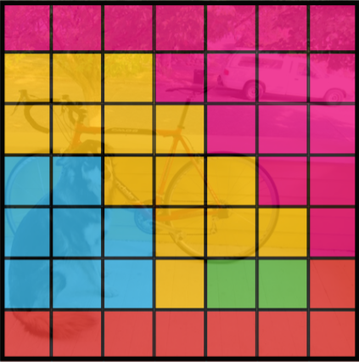
YOLO| Steps – Class Prediction
Class Prediction
Each Cell predicts C conditional Probabilities
These Probabilities are conditioned on the grid cell containing object

Slide 27
Steps to Training Models
Setup YOLOV8
Collecting dataset
Annotation or Labeling images
Yaml file
Prediction results images

Slide 28
Setup YOLOv8
Ultralytics
Organization of YOLO
Advanced version with additional features
Better than Standard open-source offering

Slide 29
Collecting dataset
Improve accuracy
Prediction and classifications on new unseen dataset

Slide 30
Annotation or labeling images
LabelImg is a graphical annotation tool
Drawing bounding boxes around objects in images
Assign label to those objects

Slide 31
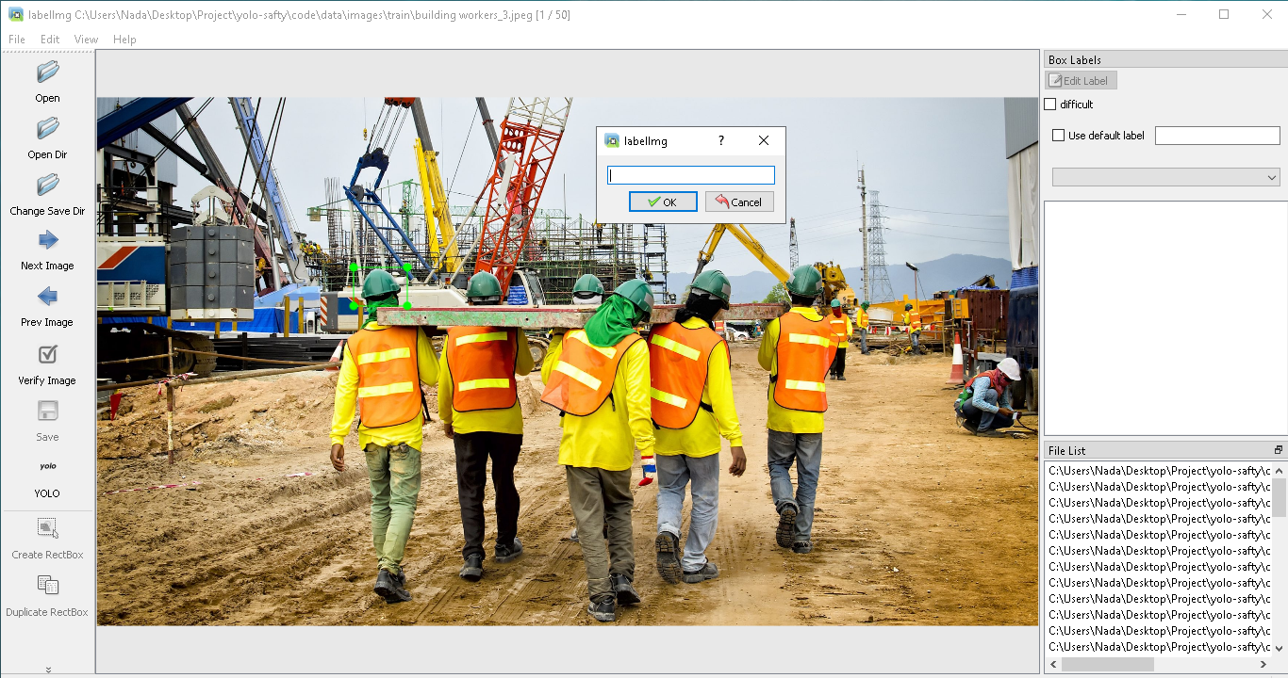

Slide 32
YAML file
Configuration information
Path, training, validation and testing images
Classes

Slide 33
Prediction images
“best.pt” from train model
Achieved best performance on the validation set during training
Test prediction of training model on images, videos or using camera

Slide 34
Training Models
Application of CV in a Factory
Safety detection
Quality Inspection
Crowd detection

Slide 35
Safety
Custom Detection
Fainted or Drowsy
Fire Detection

Slide 36
Custom Detection

Slide 37
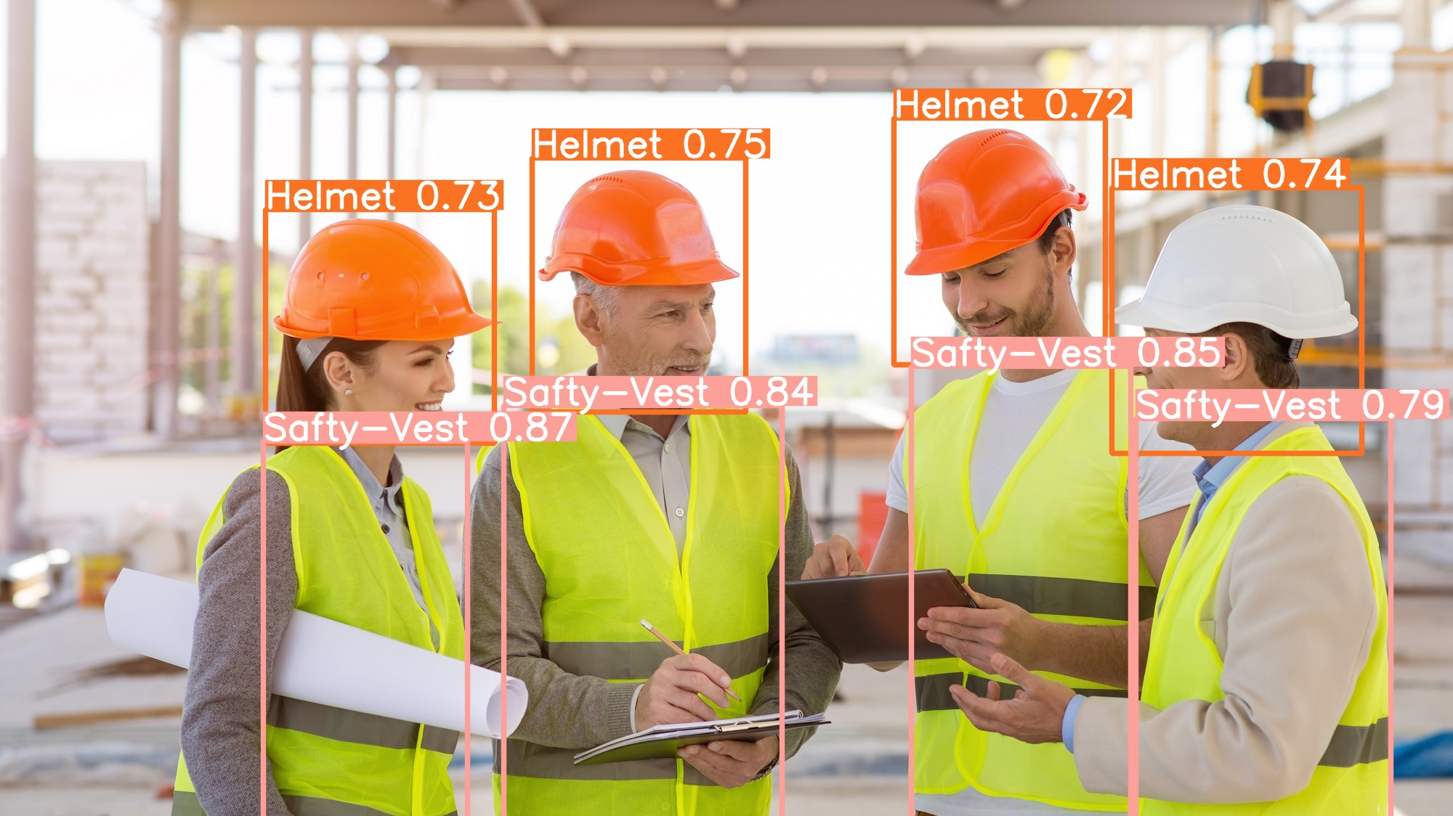
Helmet and Safety-Vest Detection

Slide 38
Fainted or Drowsy

Slide 39
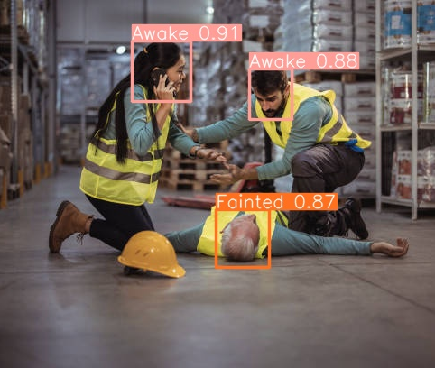
Awake and Fainted Detection

Slide 40
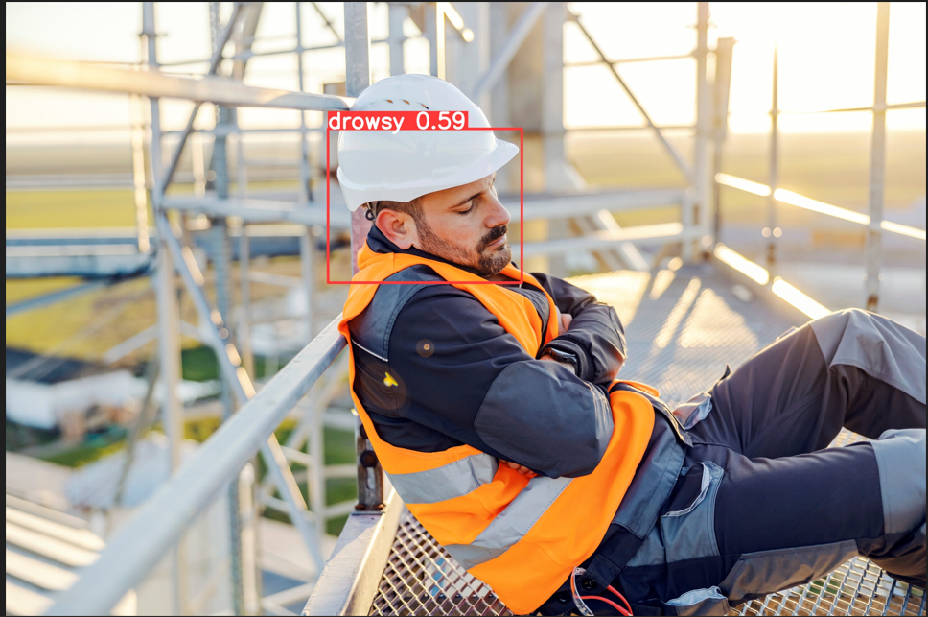
Drowsy Detection

Slide 41
Fire Detection

Slide 42
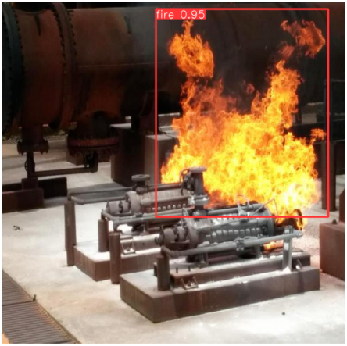
Fire Detection

Slide 43
Quality Inspection
Product detection
Defect detection
Product counting

Slide 44
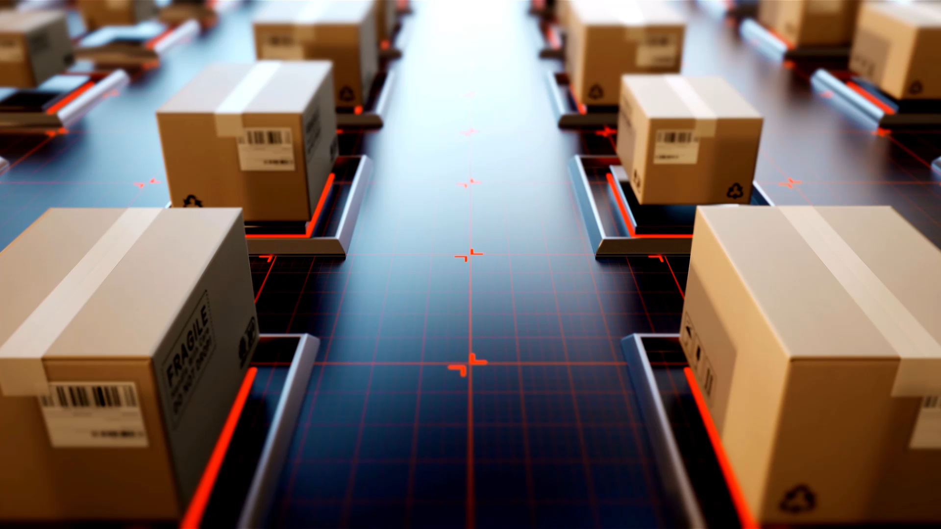
Product detection

Slide 45
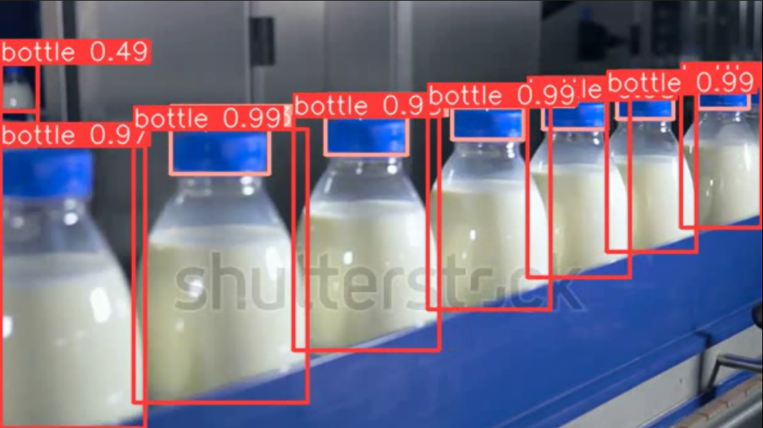
Example product: bottles of milk

Slide 46

Product counting and Tracking

Slide 47
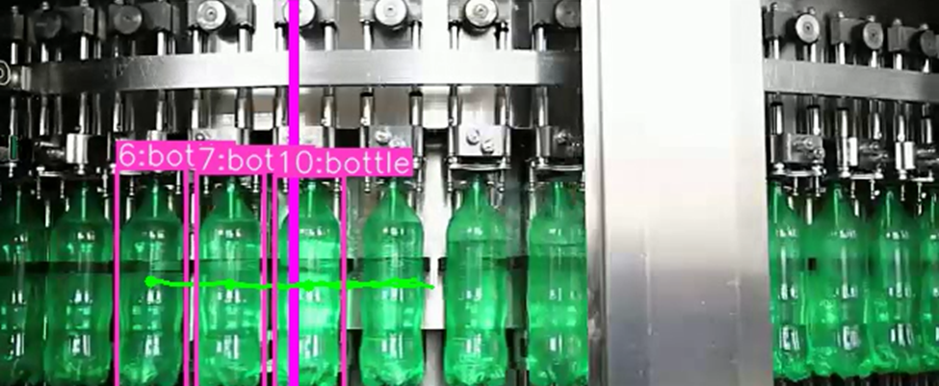
Counting and tracking 7 bottles

Slide 48

Defect Detection and Classification

Slide 49
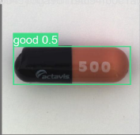
Good product detection

Slide 50
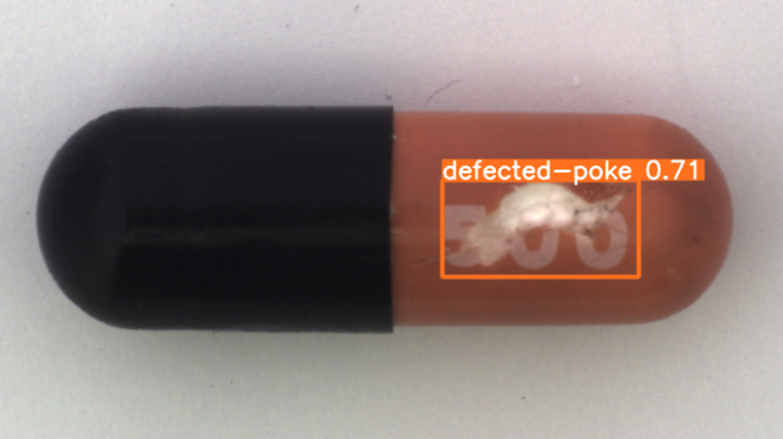
Defected Product Detection

Slide 51
Crowd Detection

Slide 52
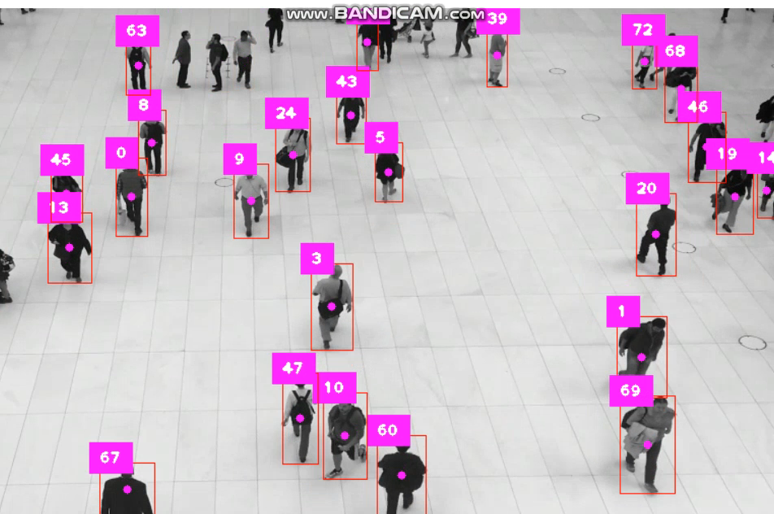
Counting people and detect crowd

Slide 53
E
B
C
A
E
D
Future work
Embedded system
Computer vision
Desktop Application
Introduction

Slide 54
E
B
A
D
C
Future work
Computer vision
Embedded system
Desktop Application
Introduction
Notes:
سلايد فيها اننا هنتكلم عن اللورا وعن الهاردوير

Slide 55
Implementing LoRa Communication
Using STM32 as Sender and ESP32 as Receiver

Slide 56
Overview of LoRa Technology
An Introduction to Long Range (LoRa) Communication

Slide 57
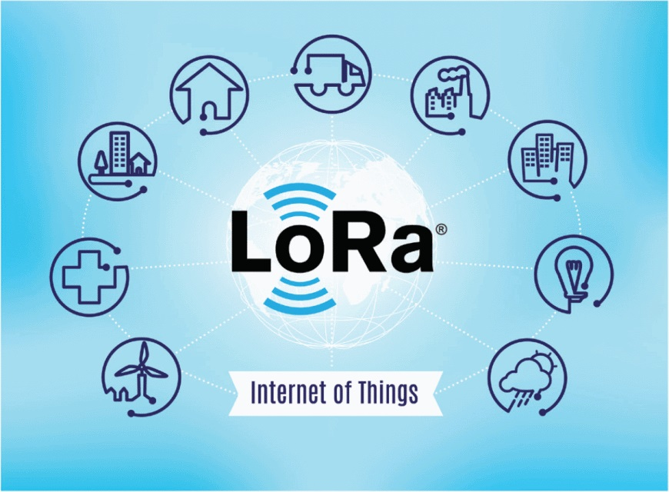
Definition
Purpose

Slide 58
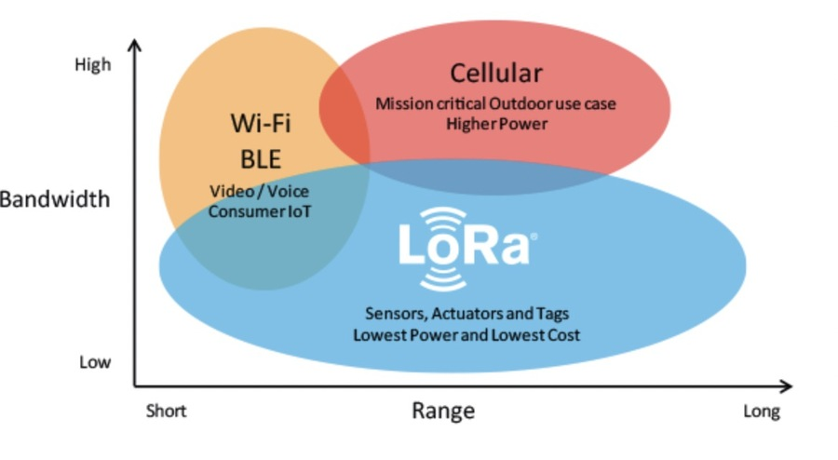
Key Features
Long Range
Bandwidth
Low Power Consumption

Slide 59

Frequency Bands
High Capacity
Secure
Cost-Effective

Slide 60
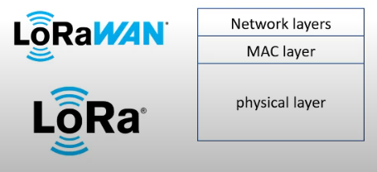
How LoRa Works
A LoRa network relies on two componets :
LoRa
LoRaWAN

Slide 61
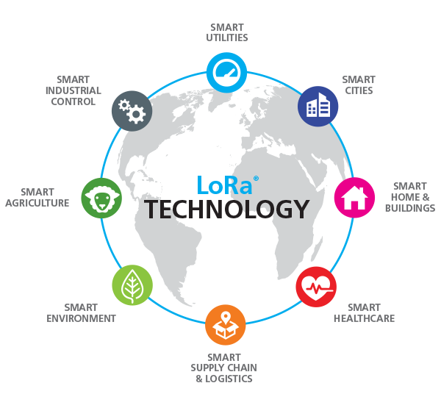
Applications
Smart Cities
Agriculture
Environmental Monitoring
Industry

Slide 62
Managing Environmental Safety
Warning System for Gas Leaks: To detect gas leaks and send real-time warnings to prevent potential accidents or health hazards to factory personnel.
Temperature and Humidity Control: To monitor temperature and humidity levels within the factory environment to ensure optimal working conditions.

Slide 63
Data Flow
1
Data Acquisition
2
STM32 Processing
3
LoRa Modulation
DHT22 and MQ4 sensors are used to measure temperature, humidity, and gas concentrations.
Sensor data is modulated using LoRa technology for long-range transmission
STM32 microcontroller processes and packages the sensor data for transmission.

Slide 64
4
Data Transmission
5
ESP32 Reception
ESP32 receives the data and processes it for further analysis or display.
The processed data is transmitted wirelessly to the ESP32 receiver.

Slide 65

Sensors Overview

Slide 66
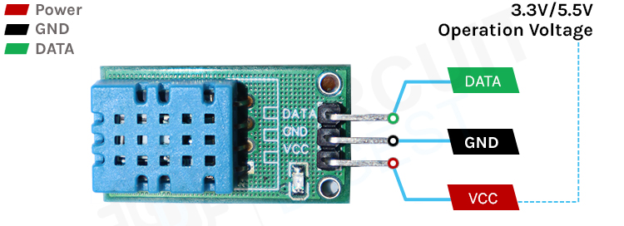
Understanding the DHT11 Sensor
Temperature and humidity sensor

Slide 67
Why Choose DHT11?
Simplicity and Ease of Use
Cost-Effective
Reasonable Accuracy
Low Power Consumption (0.3mA)

Slide 68
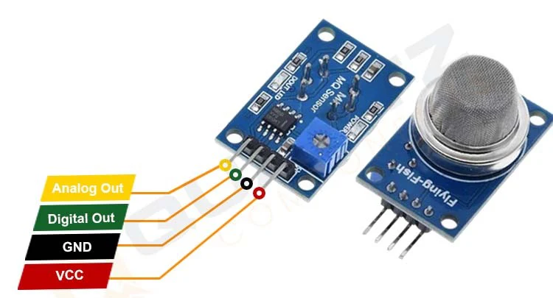
Understanding the MQ4 Sensor
The MQ4 is a semiconductor sensor used for detecting the presence of methane (CH4) in the air.
It can also detect other gases like LPG, CO, Alcohol, and Smoke to some extent.

Slide 69
Why Choose MQ4?
Wide range Gas Detection
Cost-Effective
High Sensitivity
Easy to Use
Reliable
Low Power Consumption

Slide 70
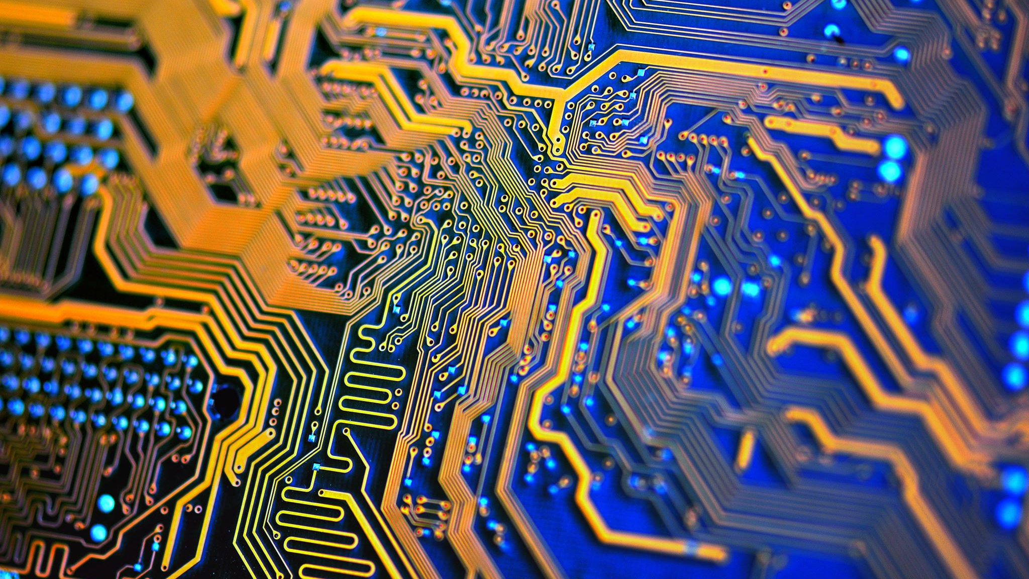
Microcontrollers Overview

Slide 71
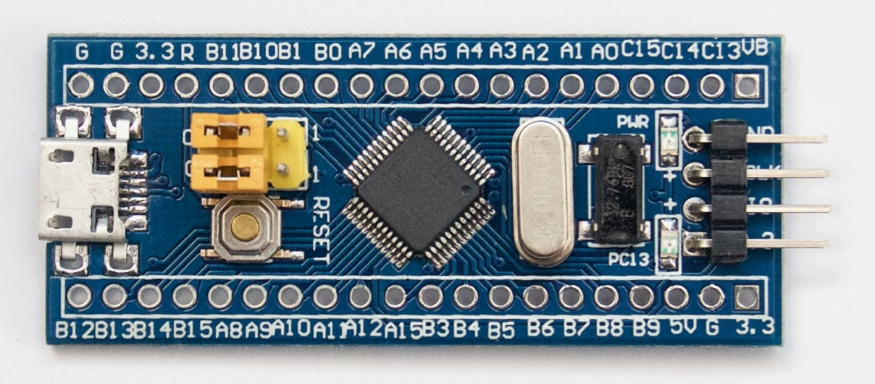
STM32 as a Sender
STM32 is a family of 32-bit ARM microcontrollers

Slide 72
Why Choose STM32 ?
High Performance
Low energy consumption
Extensive connectivity options
Rich Peripheral Set

Slide 73
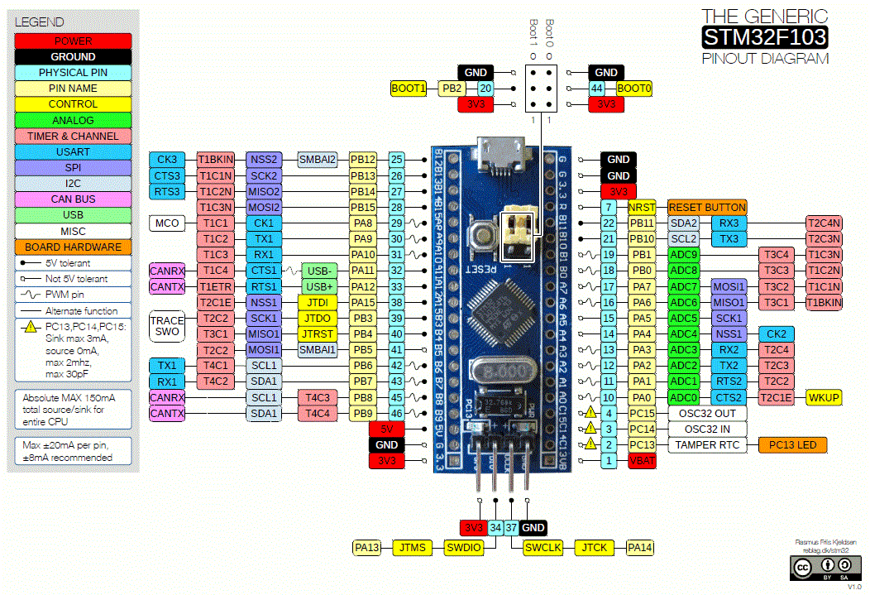

Slide 74
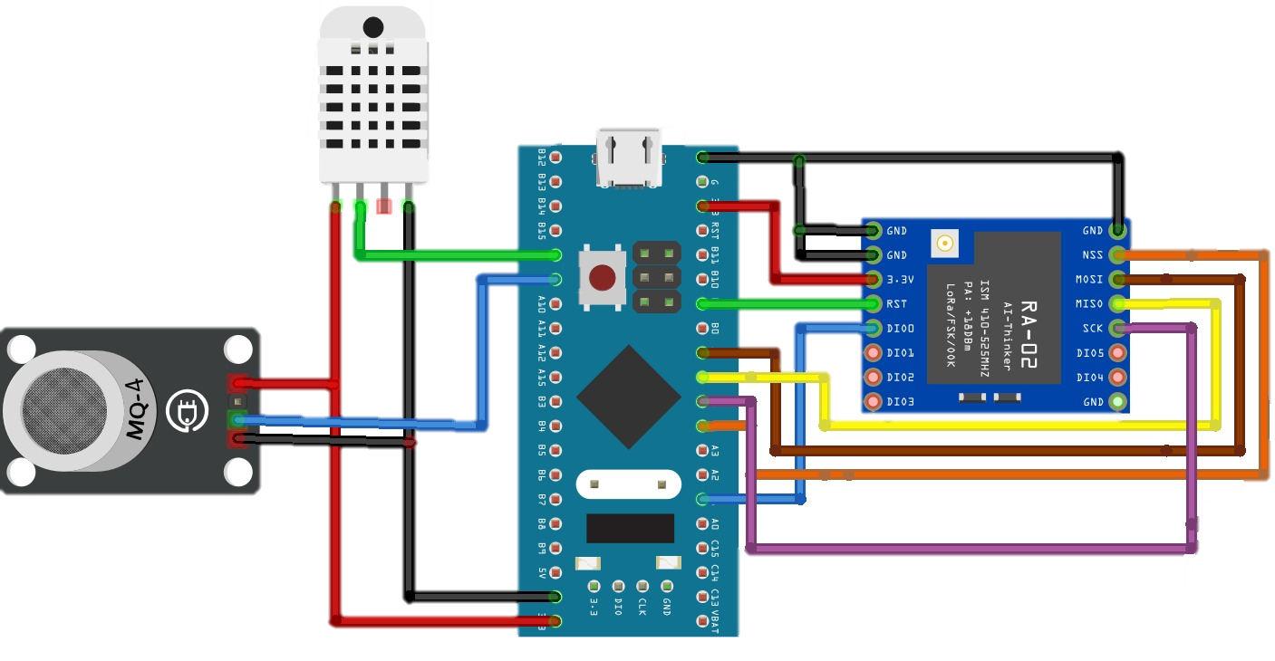
STM32 and LoRa Module Integration with the Sensors

Slide 75
Hardware Setup With STM32F103C8
SX1278 (LoRa) | STM32F103C
GND | GND
VCC | 3.3V
RST | PB0
SCK | PA5
MISO | PA6
MOSI | PA7
NSS | PA4
DIO0 | PA1

Slide 76
Hardware Setup With STM32F103C8
DHT11 | STM32F103C
GND | GND
VCC | 3.3V
DATA | PA8

Slide 77
Hardware Setup With STM32F103C8
MQ4 | STM32F103C
GND | GND
VCC | 5V
AO | PA9
DO | PB0 (optional)

Slide 78
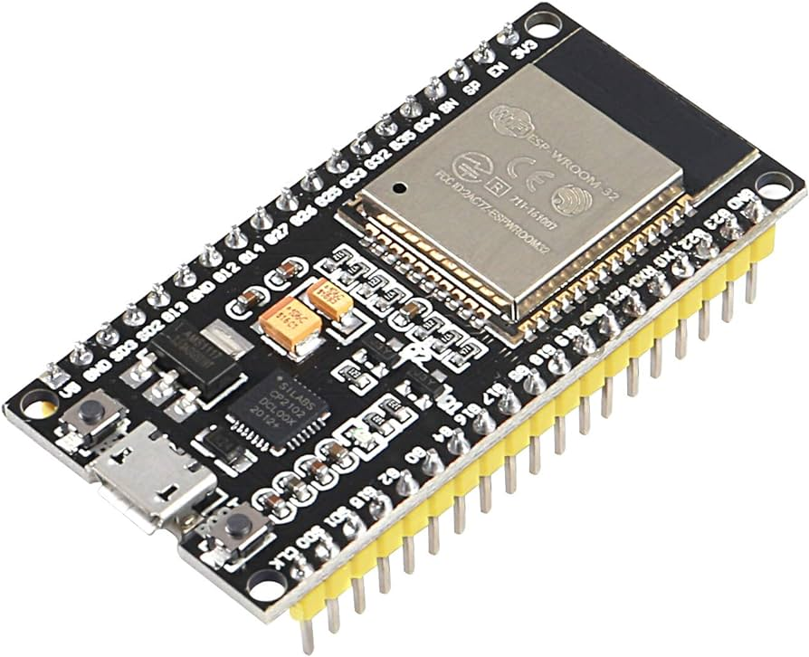
ESP32 as a Receiver
ESP32 is a powerful microcontroller with built-in Wi-Fi and Bluetooth capabilities.

Slide 79
Why Choose ESP32 ?
Dual-Core Processor
Integrated Wi-Fi and Bluetooth.
Rich Peripheral Interface Options
Low Power Consumption
Affordability and Availability

Slide 80
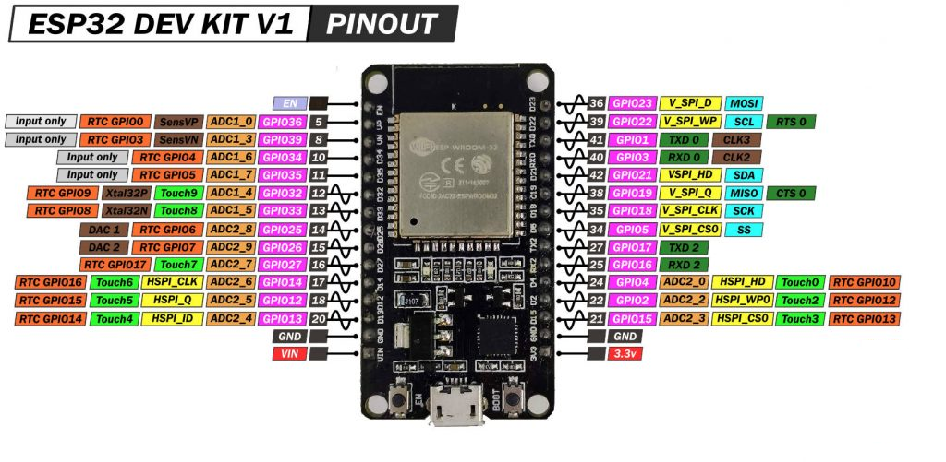

Slide 81
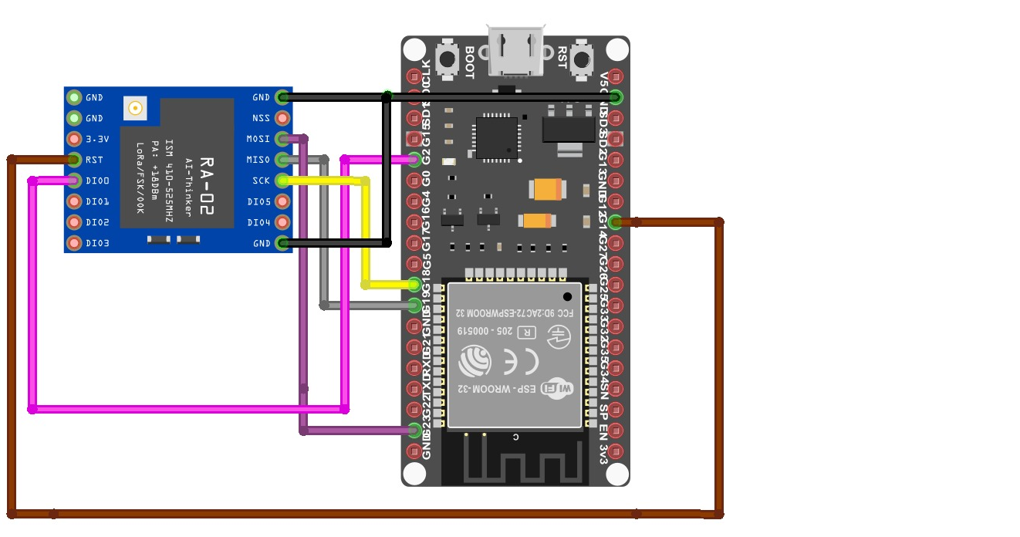
ESP32 and LoRa Module Integration
SX1278 (LoRa) | ESP32
GND | GND
VCC | 3.3V
RST | D14
SCK | D18
MISO | D19
MOSI | D23
NSS | D5
DIO0 | D2

Slide 82
E
B
C
A
E
D
Future work
Embedded system
Computer vision
Desktop Application
Introduction

Slide 83
E
B
C
A
D
Future work
Embedded system
Desktop Application
Computer vision
Introduction

Slide 84
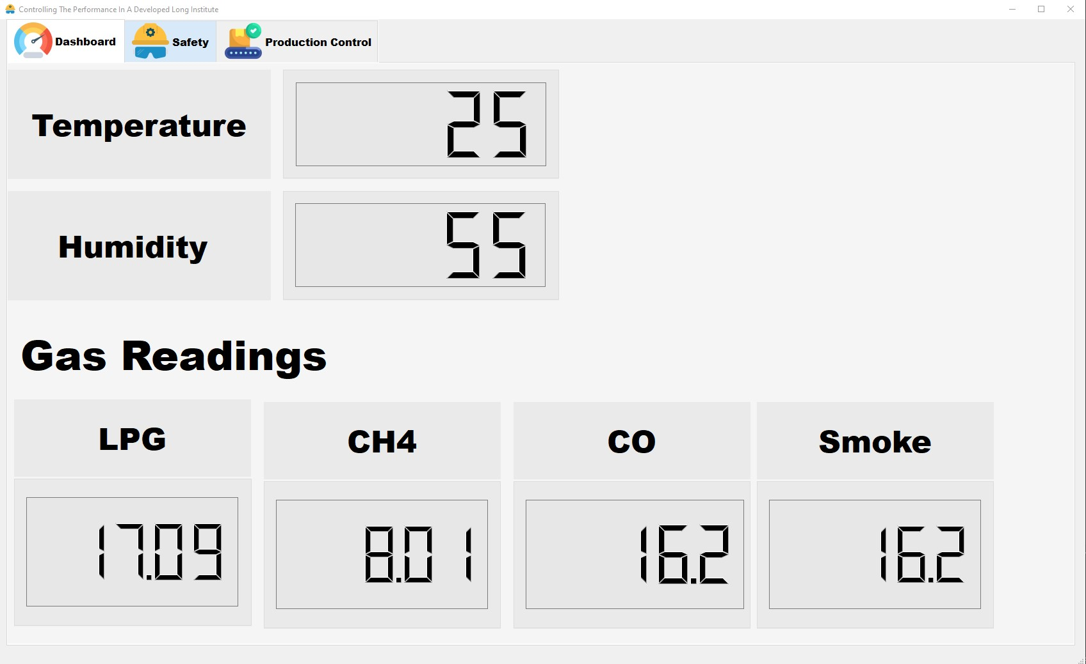

Slide 85
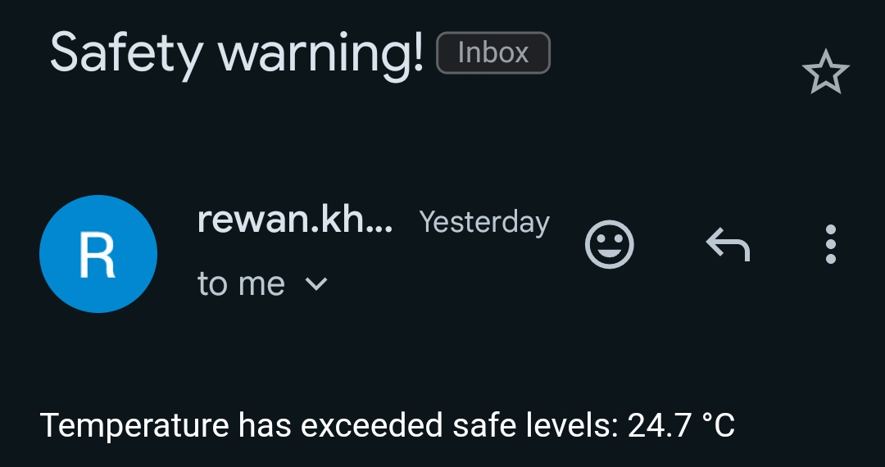

Slide 86
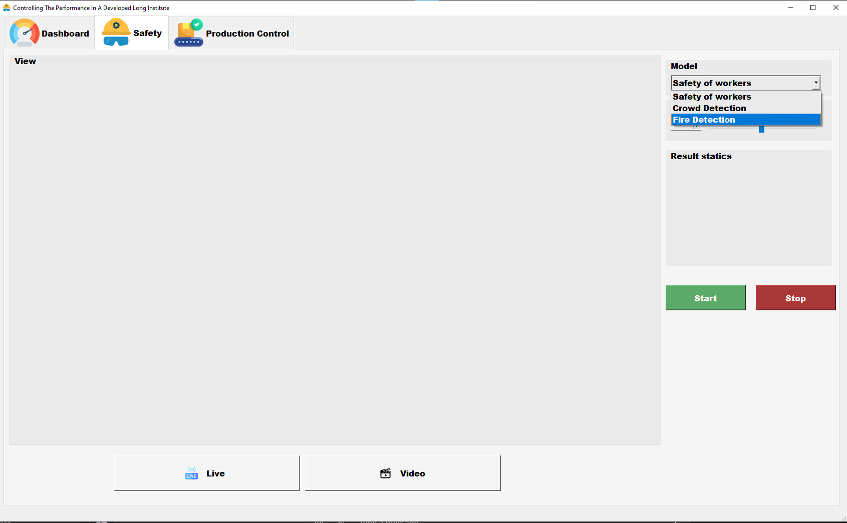

Slide 87
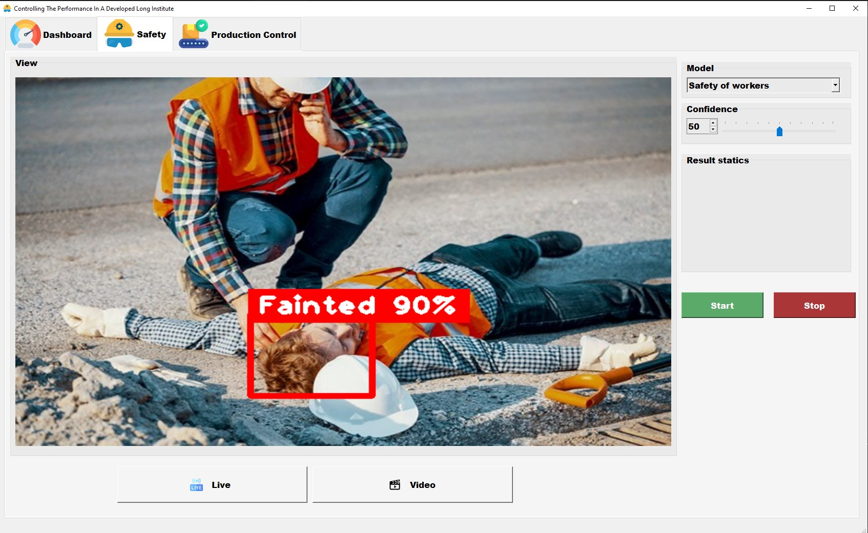

Slide 88
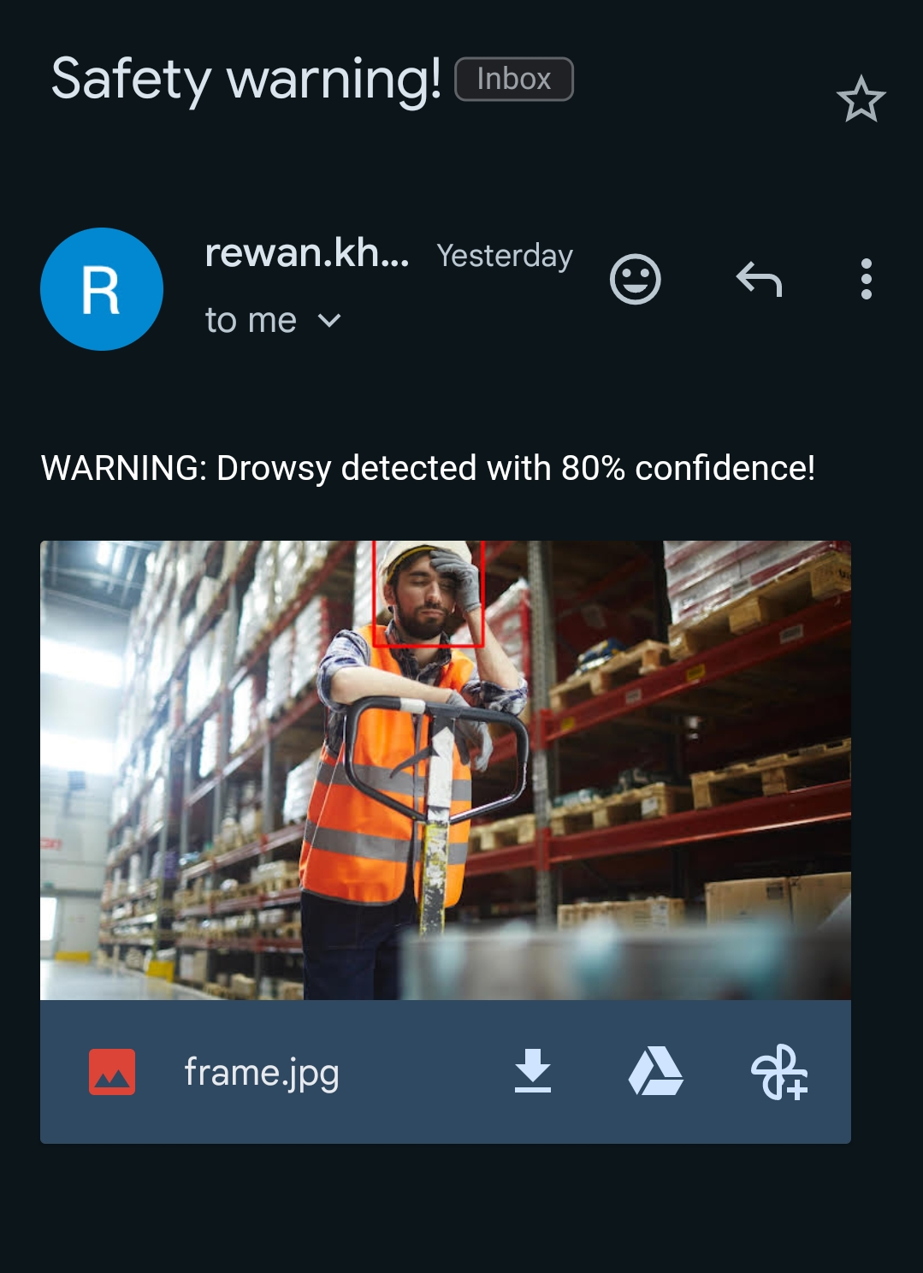

Slide 89
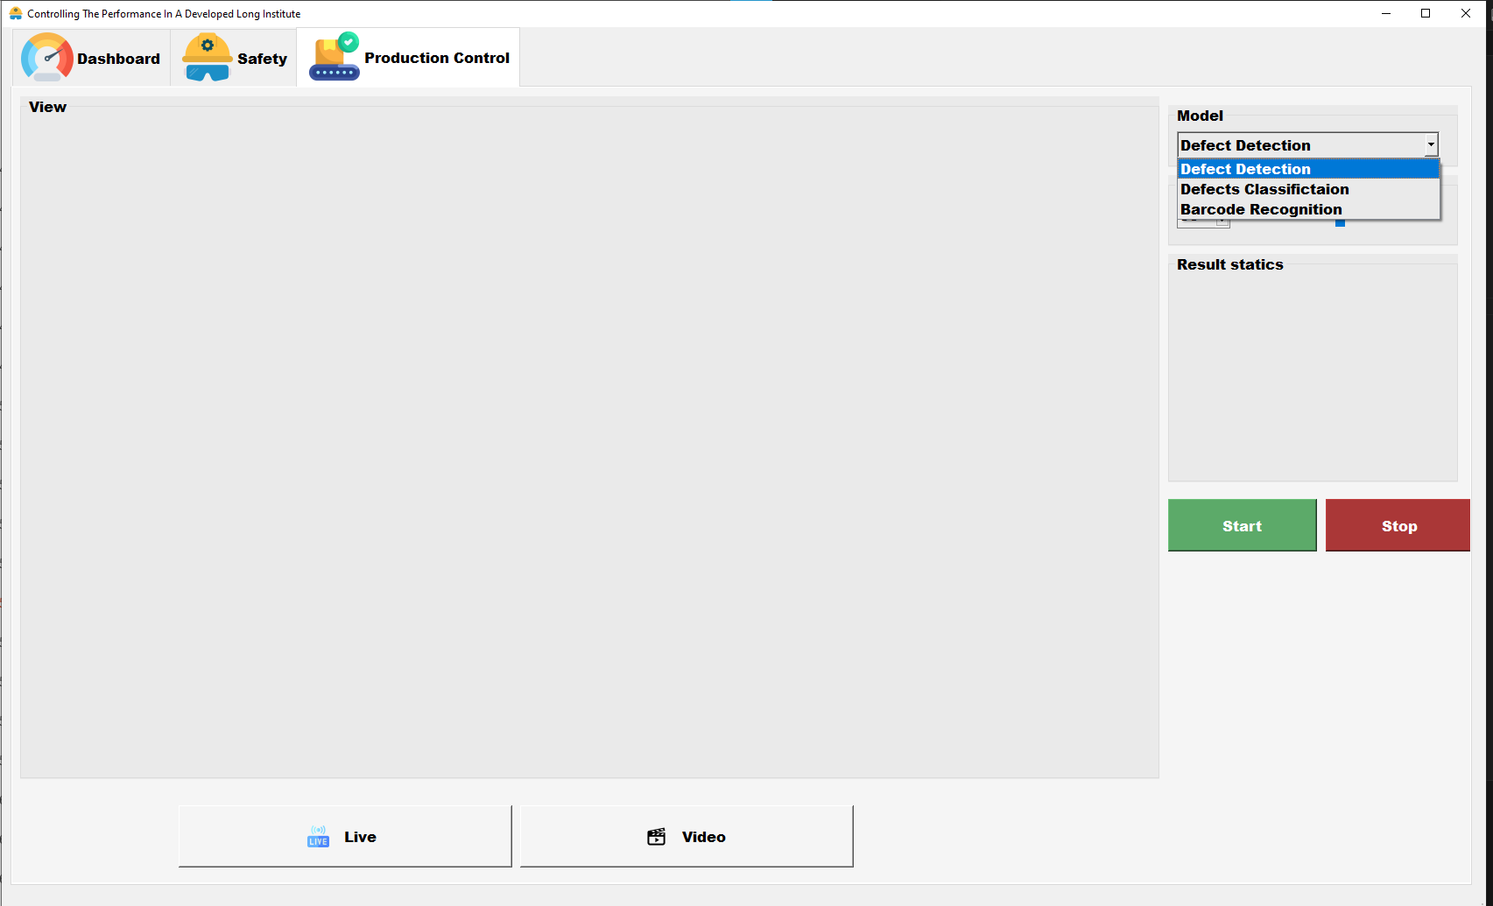

Slide 90
Live Demo

Slide 91
Conclusion and Future Work

Slide 92

Main Achievements Of The GUI
User-friendly interface
Real-time video processing and model selection functionality

Slide 93
Future Work
Worker Health Monitoring
Real-Time Alerts and Automation
Cybersecurity Measures

Slide 94
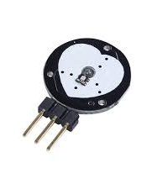
Worker Health Monitoring
Integrate wearable biometric sensors
Continuously monitor workers' vital signs
Use machine learning algorithms for personalized baseline establishment.

Slide 95
Real-Time Alerts and Automation
real-time alerts for safety risks and operational inefficiencies.

Slide 96

Cybersecurity Measures
Strengthen cybersecurity across the system.
Implement encryption protocols and secure authentication.
Conduct regular security audits.

Slide 97
E
B
C
A
E
D
Future work
Embedded system
Computer vision
Desktop Application
Introduction

Slide 98
B
C
A
D
E
Future work
Embedded system
Computer vision
Desktop Application
Introduction

